Slide 1
Application Development in the iOS Environment - Assignment 3 Presentation
Group 101 - Jelisha de la Cruz, Divraj Singh, Jessie Chan

Slide 2
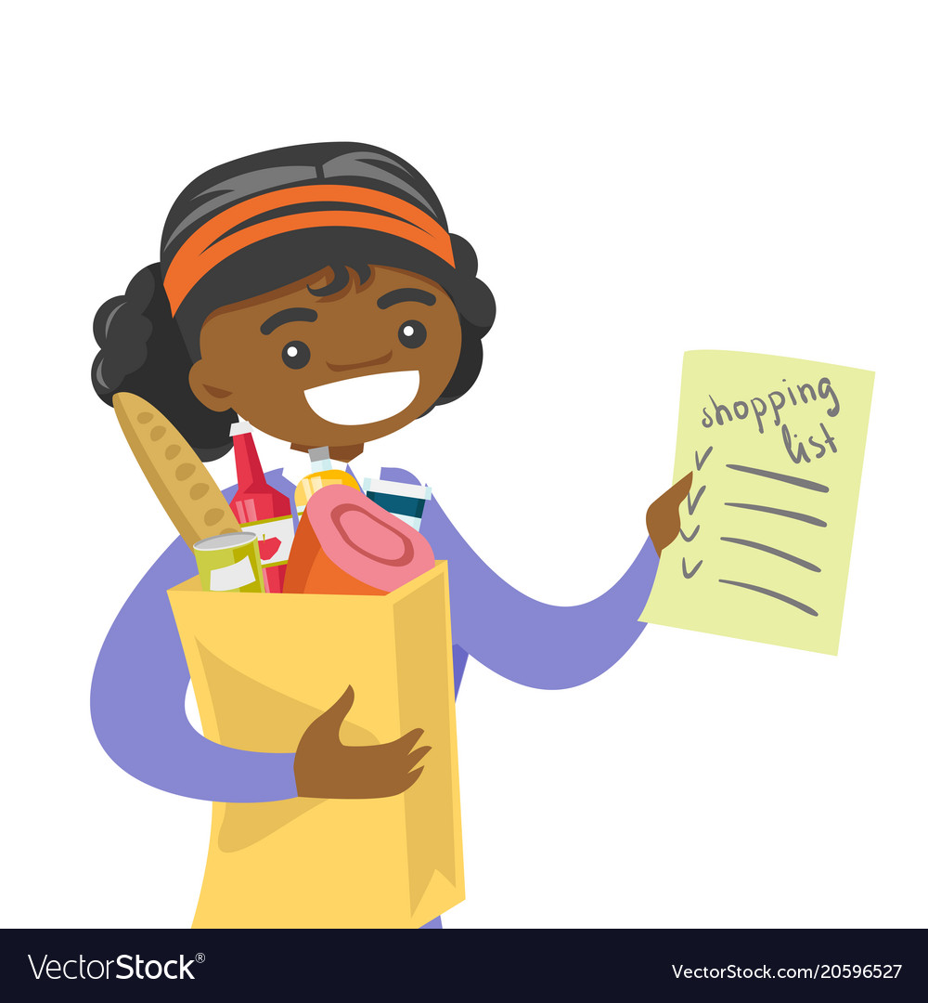

Target Audience
General public from adolescent up; Anyone who goes grocery shopping
Focus on helping people busy with everyday life easily access and utilize the app to make their life a bit easier
Notes:
Target audience is anyone who would need to go buy groceries - from high schoolers taking errands after class to working adults buying ingredients for dinner after work to the elderly
Simply for ease of access, especially for those who experience difficulty manoeuvring smartphones or will have too many things in their hands to handle their phone

Slide 3
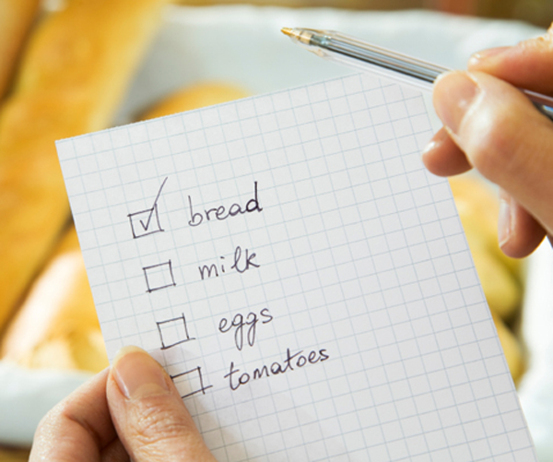
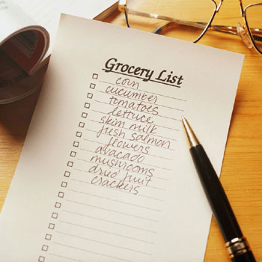
Problems our application solves
Human errors/flaws
Use of physical notes/reminders that could be forgotten or left behind
Memory is not always reliable
Lack of accessibility
Phones are constantly on hand
Siri can recite or record your list for you
Notes:
Easy on-hand access to a list - everyone has a phone, and with the app and Siri, there is not even a need to unlock the iPhone(?)
No need to worry about human error - trying to memorize risks possibility of forgetting when at the super, and written physical notes and reminders can be lost or left behind or forgotten anyway
Even people who would have difficulty accessing their phone - whether due to difficulty in handling smartphone physically or visually - Siri can simply recite the list or record the list for you

Slide 4

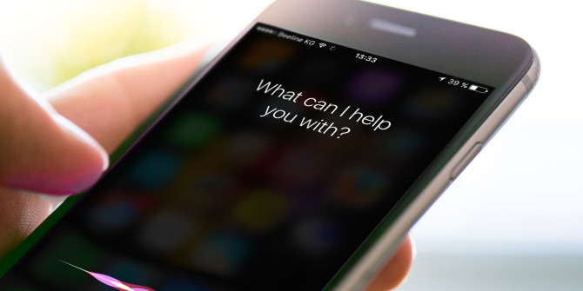
Frameworks: Sirikit
Allows access to Siri; Contains Intents and Intents UI frameworks
Receives user requests and translates into app-specific actions within and out of app:
Adding/Recording list
See/Display list
Delete from list
Notes:
Frameworks is Sirikit. Encompasses Intents and Intents UI frameworks, allowing us to implement app extensions that integrate into services with Siri. Can receive user requests via Sirikit and turn into app-specific actions and also display branding/other customized content in Siri interface after user request is fulfilled. We utilized Siri in order to make our app more accessible:
We can use Siri to write down our list for us - within the app and outside the app
Can use Siri to display/recite to us our list - in and out of the app
Can use Siri to delete items from our list for us

Slide 5
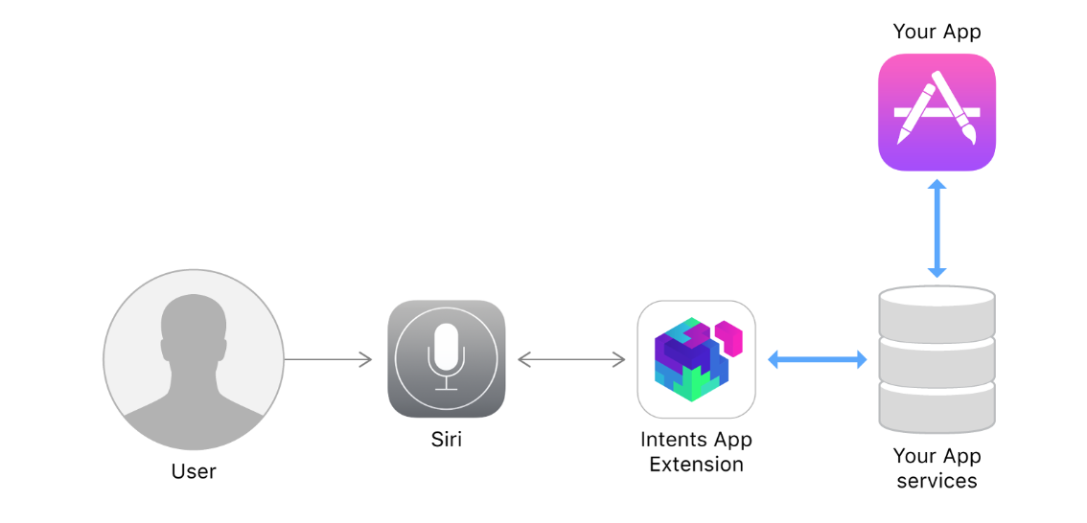
Structure

Slide 6
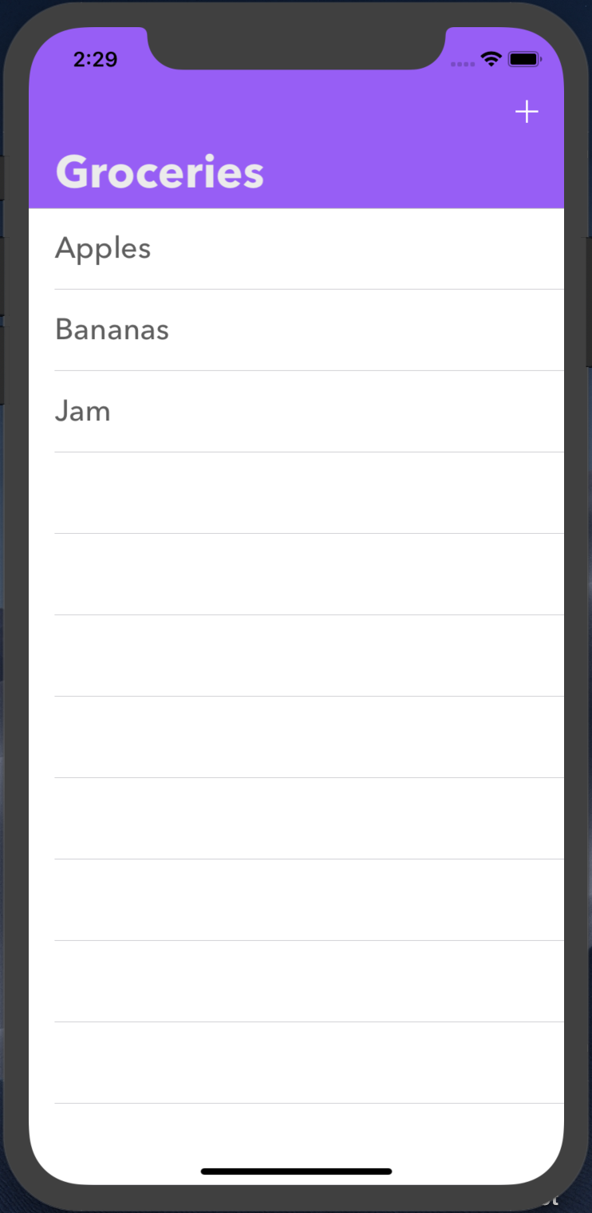
How our application works
Grocery List:
Creates and manages a list
Can add and remove items
Utilizes Sirikit to:
Add items
Delete items
Access list both inside and outside of application

Slide 7
Design and Development Process
Brainstorm
Created our own ideas, then discussed which was best - Grocery List
Planning
Discussed what features we would like to include in our app
Prototype & Peer Feedback
Created basic version of app accessible without Sirikit
Feedback from peers allows us to consider further functions to add to our app
Peer Assessment & Further Development
Did not have many changes due to lack of access to Sirikit, got feedback based on what we had
Still had no access to Sirikit, simply refined table
Adding Sirikit functions into our app
Finally got access to Sirikit and began development on adding the Sirikit related functions
Notes:
Brainstorm: Each of us brainstormed for a certain amount of time which type of kit we wished to use as a framework for the project. After time was up, we presented our ideas to each other and then chose the one which we decided was most accomplishable within the timeframe given but also complex enough for this project
Planning: After deciding on what our app should be, we discussed together the main functions and features of the app, as well as any functions we would add on if we had the time after
Prototype & Peer Feedback: We created a very basic version of our app. At this point, we had yet to have access to Sirikit and therefore only worked on the table and table view functions and features. Feedback from peers was very helpful and useful as we were able to consider further functions to possibly add to enhance user experience
Peer Assessment & Further Development: Still had no access to Sirikit and so was unable to make much progress other than get the table functioning. Was not able to show much for peer assessment but had a few basic functions down. Afterwards, was able to get it functioning fully sans the Sirikit functions. Upon finally getting access to Sirikit, finally able to work on Siri

Slide 8
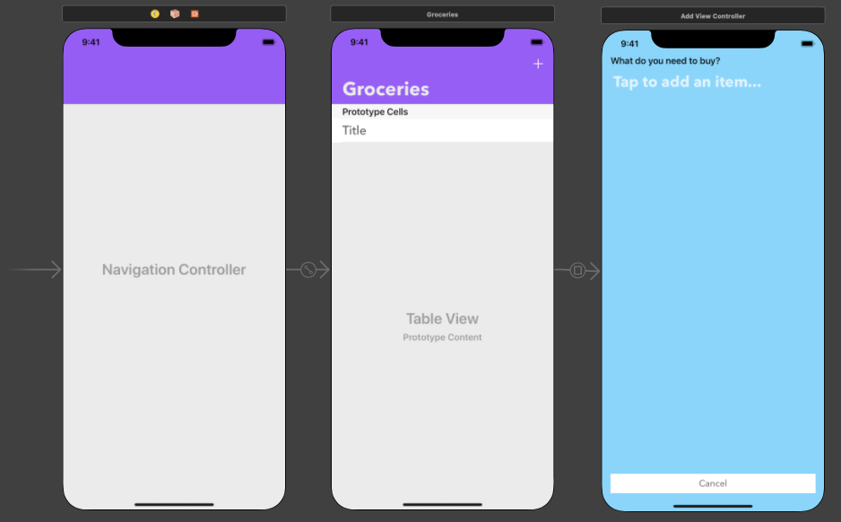
Brainstorming and Planning
Brainstormed multiple ideas from different kits
Chose to create a Grocery List
Focus on simplicity
Focus on getting basic functions down:
Adding
Deleting
Display

Slide 9
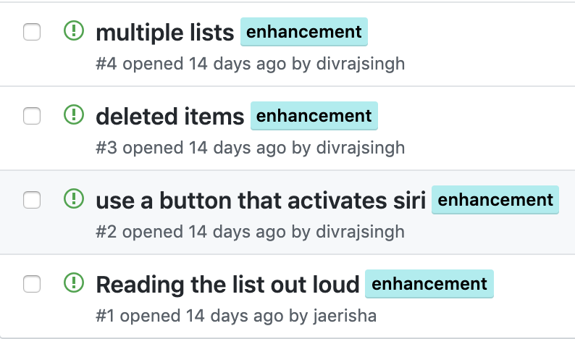
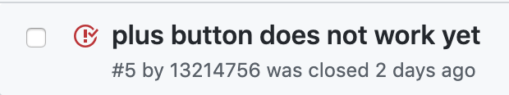
Peer Feedback & Further Development
Feedback gave ideas for extra features:
Implementation of multiple lists
Retaining deleted items
Activating Siri from within the app
Siri reading the list out loud
Completed functions allowing manual adding and deleting of items
Adding Sirikit functions

Slide 10
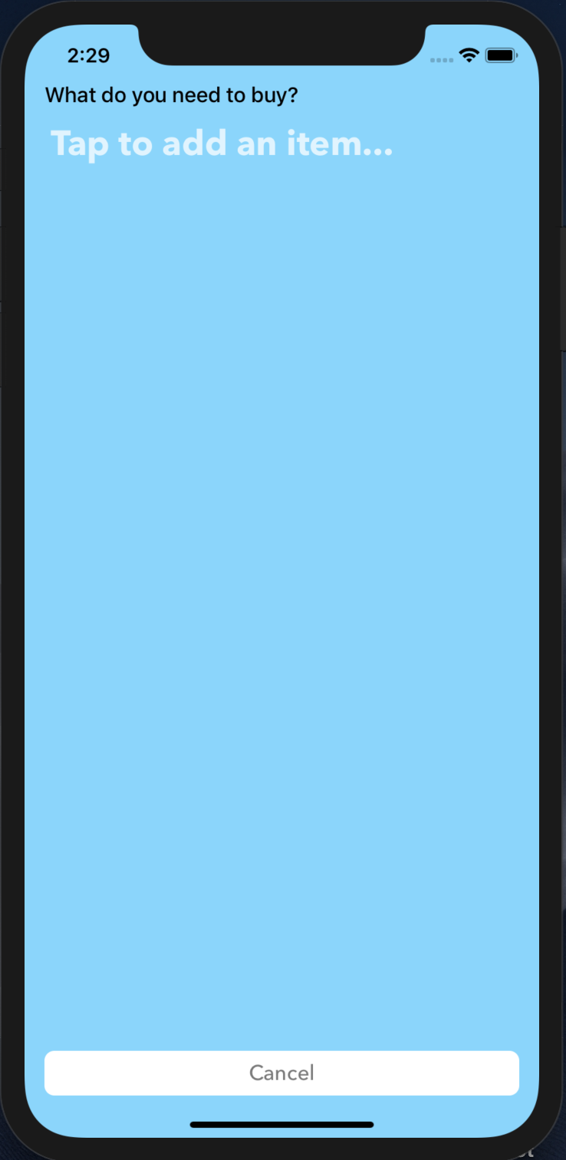
App demo time!

